Slide 1
CDB Versioning
ER Graphics / Brainstorming

Slide 2
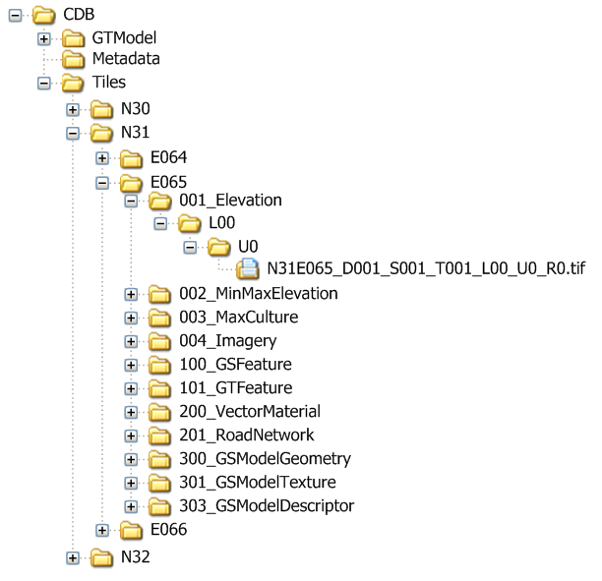
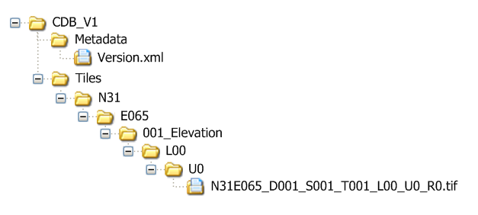
CDB Versioning – Database Revision / Updates
Start with the base CDB
Clients and tools point to this directory
1
4
Version.xml file points to base CDB
3
5
Result: every file is taken from CDB base directory except this one. File from CDB_V1 is used.
2
Create second CDB directory structure and modify the target file. Do not need to replicate entire file/dir hierarchy

Slide 3
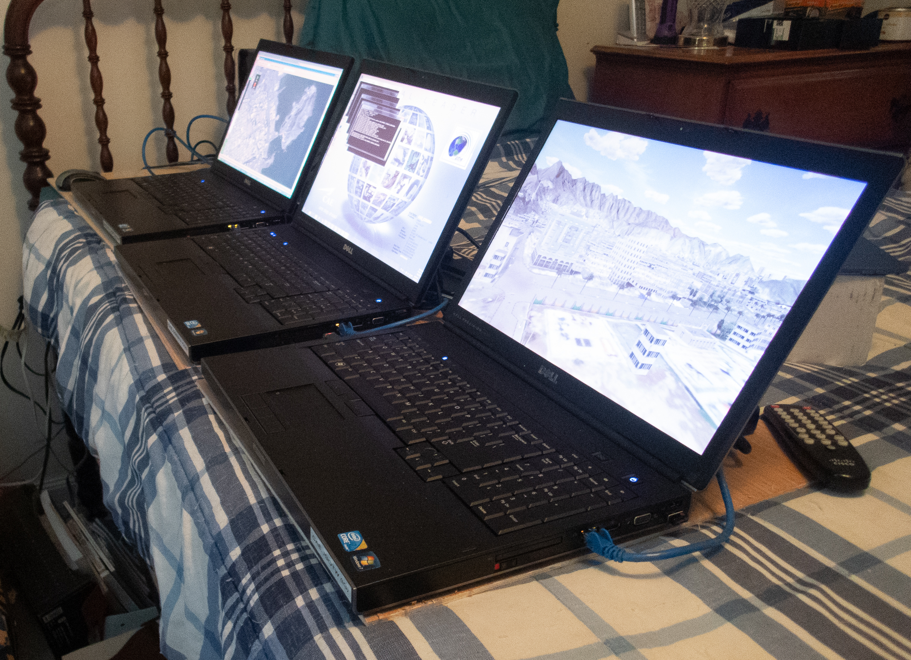
Off the shelf gigabit router; off-the-shelf Dell Laptops, circa 2011
CGF, Exercise Setup and Control; Camera Control; Radar CDB Client; Simulator system loader and launcher
CDB
Server
Image Generator CDB Client

Slide 4
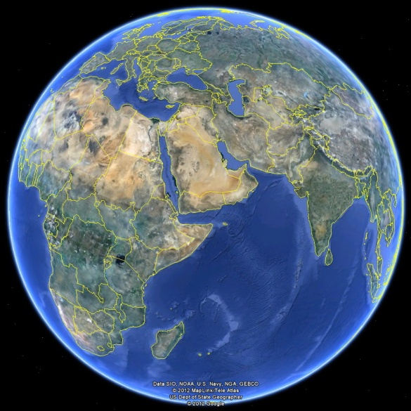
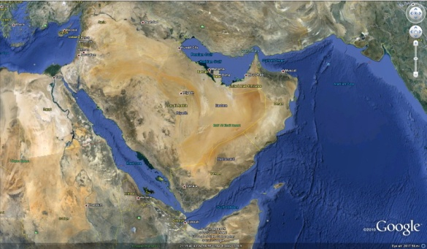
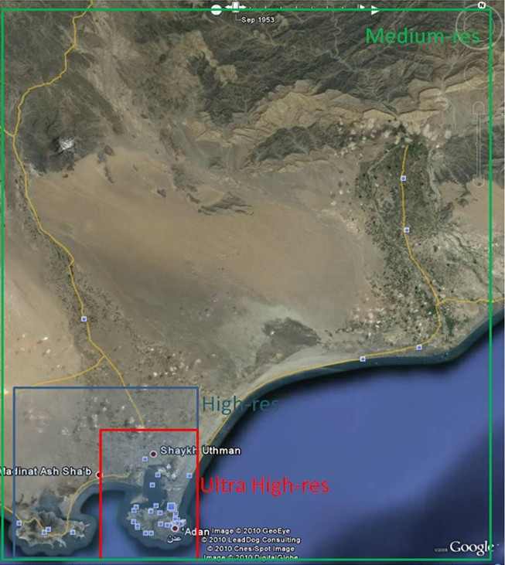

Slide 5
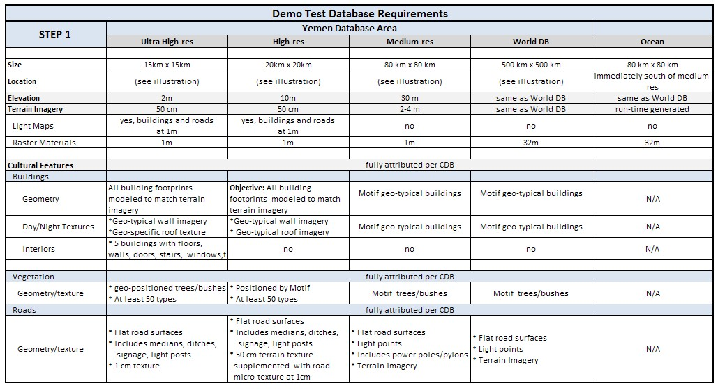

Slide 6
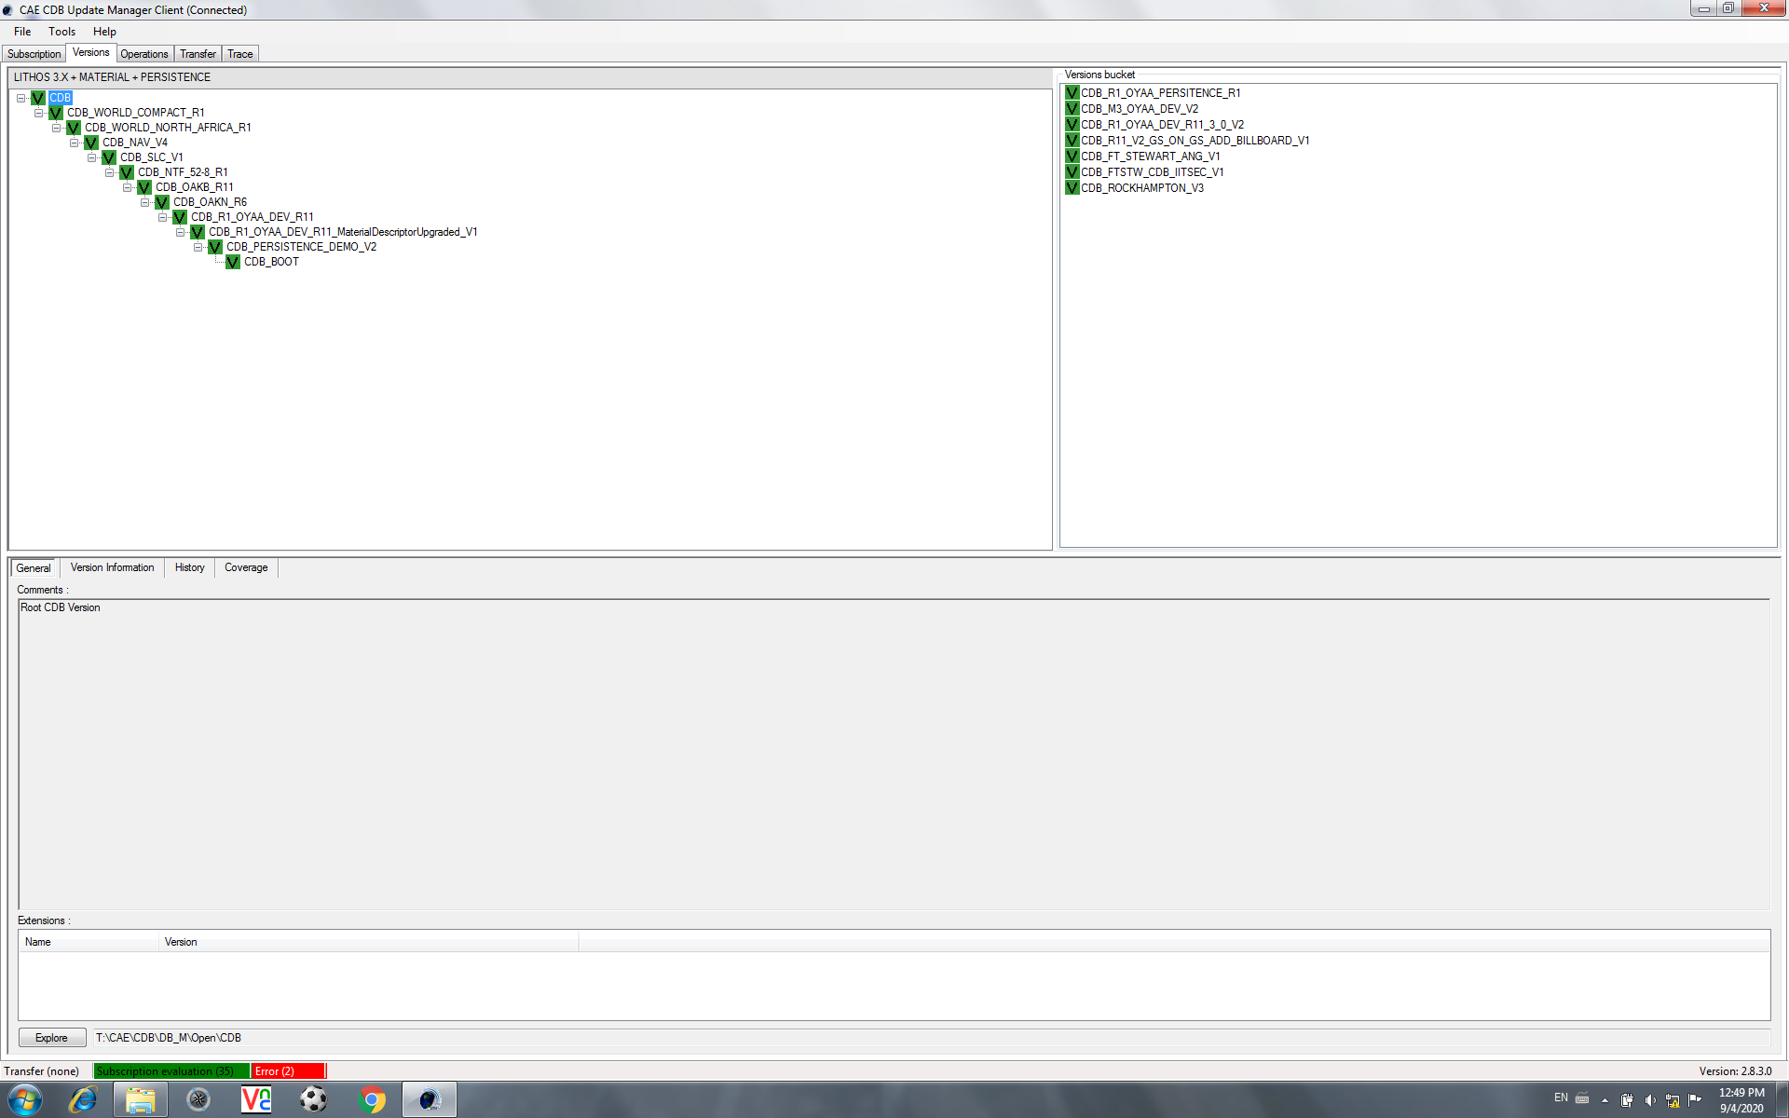
‘Area/Airport Databases – medium to high resolution
SLC – Salt Lake City
NTF – NATO Training Facility
OAKB – Kabul
OAKN - Kandahar
CDB datasets that are present on-disk at the CDB Server, but not linked into the current run-time layout/hierarchy
CDB [root] and CDB_BOOT are standard bookends for the on-disk repository to be accessed at run-time startup
Area / Target Databases. OYAA is Aden, Yemen. This is the dataset, modified with non-licensed, procedurally generated ‘imagery’, that is available from Presagis for experimentation on the Tech Sprint.
CDB_R1_OYAA_DEV-R11 is the ‘main’ Yemen dataset; underneath it is a small version that only has upgraded MaterialDescriptors; underneath that is an R&D datalayer with dynamic changes in the Yemen Database generated by either simulation kinetics or operator modifications
CDB_WORLD_COMPACT is a low resolution imagery and elevation dataset with world wide coverage; CDB_WORLD_NORTH_AFRICA adds more content of a specific region, but still at “background” resolution
CDB_NAV_V4 is navigation data only, updated every 28 days, with worldwide coverage

Slide 7
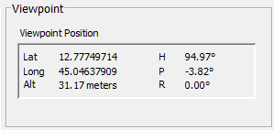
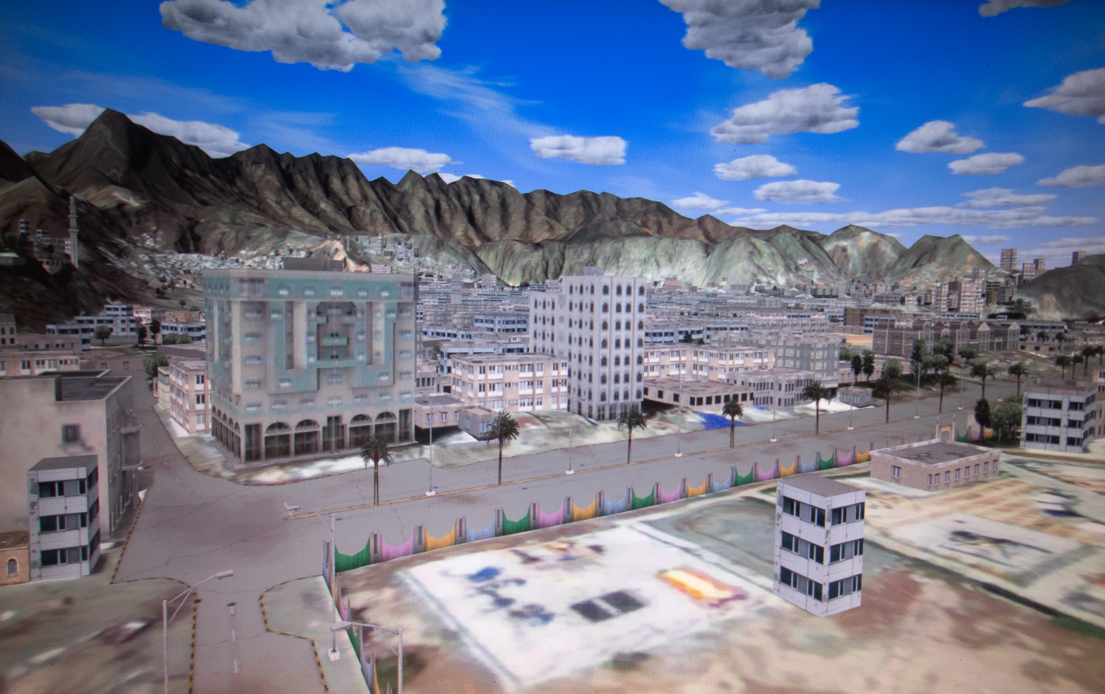

Slide 8

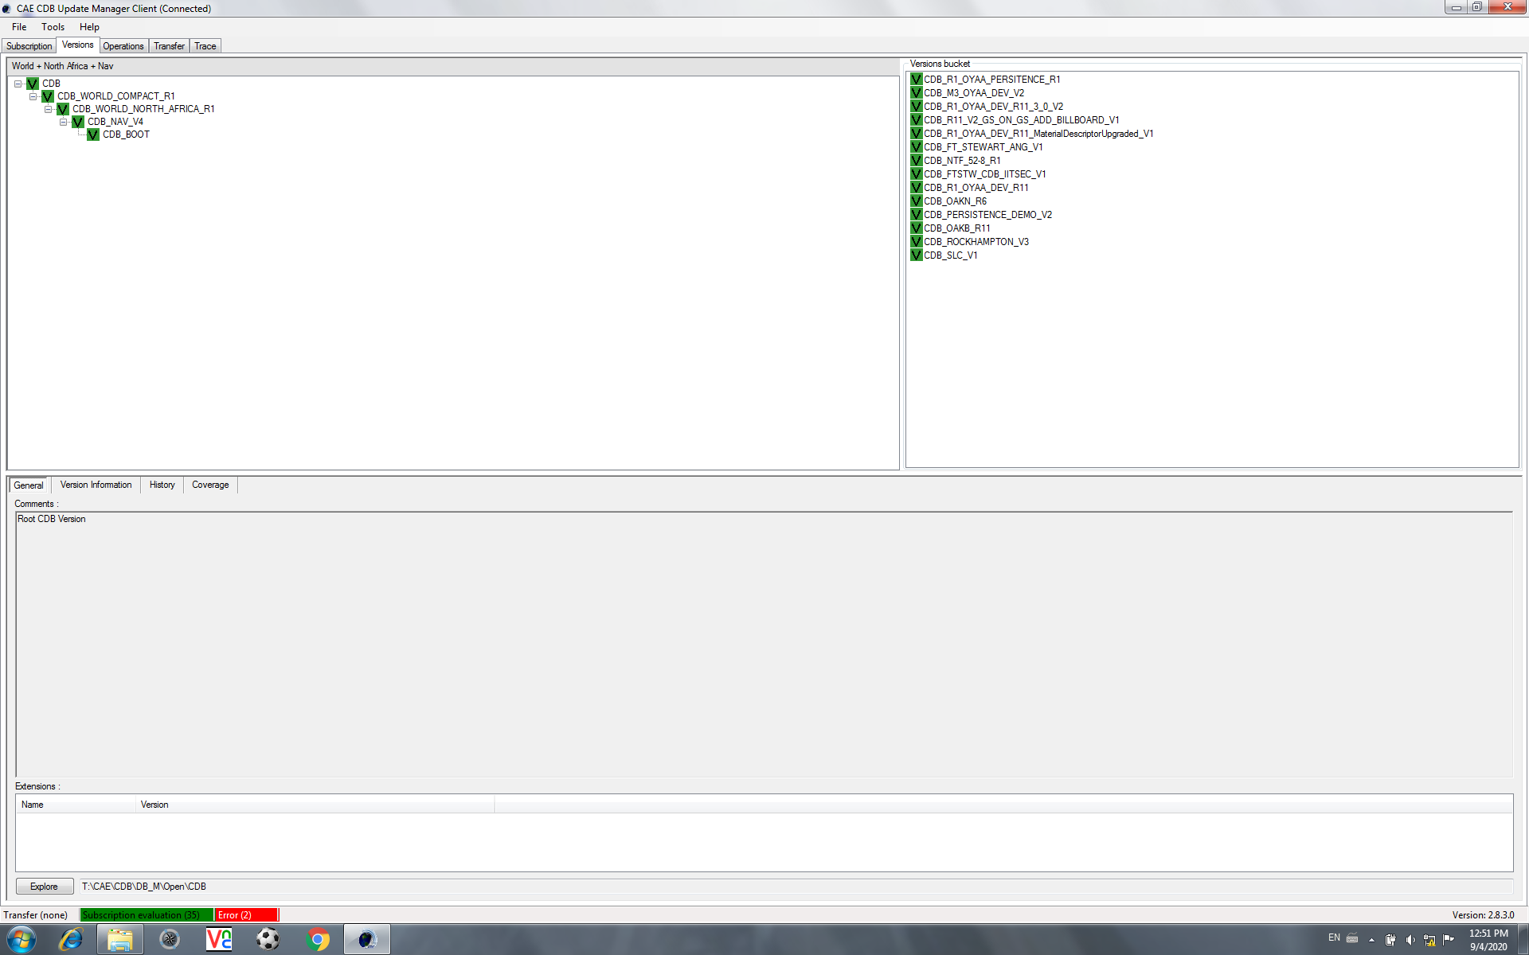

Slide 9
At the German Army Aviation Training School in Buchenberg, there are
12 helicopter flight simulators (CH-53, UH-1D, EC-135, with multiple CDB clients (out-the-window visuals; non-visual sensors; computer-generated-forces;
The CDB holdings include world-wide background data; higher resolution datasets for Europe and Germany; some country data procedurally generated; some airports procedurally generated; some country data created from satellite imagery and hand modelling; some airports created from satellite imagery and hand-modelling; both the procedurally-generated and satellite/hand modelled data under continuous update and generation of additional content;
Multiple distributed CDB servers;
Main enterprise facility CDB repository on-site;
High speed networking to offsite CDB repository at CAE Stollberg;
High speed networking to offsite Luftwaffe Fighter Weapons Center Synthetic Environment content creation site

